Slide 1

Foxx Foxx Designs
By Jaron Franklin

Slide 2
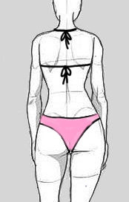
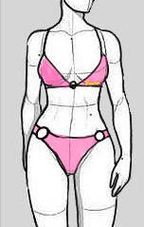
A simplistic design with a hoops on the waists and bra; a tied design on the back

Slide 3
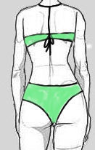
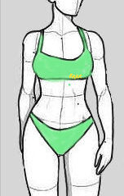
A tight support for the bra, With a tied design on the back.

Slide 4
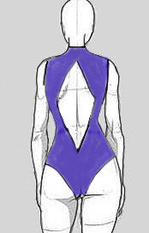
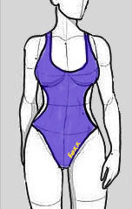
A swimming suit with a diamond opening in the back; the sides are open as well.

Slide 5
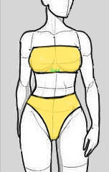
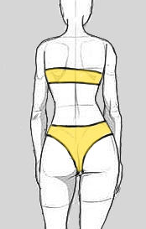
A Simple design, giving bra support.

